Slide 1


Recommendation Systems
Fall18_CSC_9010_002
Big Data Analytics Using Python
Final Project Presentation
by,
Rashmi Purvachar
Dated,
10th Dec 2018

Slide 2
AGENDA
Recommender systems?
Why use Recommendation systems?
How Does a Recommendation Engine Really Work?
Different types of recommendations
Applications of Recommendation Engines
Advantages of Recommendation systems
Netflix as an Example
Use case - Movie Recommender System

Slide 3
Recommender Systems
Recommender systems are an extensive class of web applications that involve predicting user responses to options.
They are a type of filter to narrow down a list of available options and help user find relevant items with a huge selection list, based on their unique needs and preferences.
Offering news articles to online news-paper readers, based on prediction of reader’s interests.
Recommending products based on customers’ search/purchase history.
Notes:
It is all about customization, making it tailored to an individual’s needs and preferences.
People seek information via words, recommendation letters, news reports etc.
Recommendation systems imitate this social process to enable quick filtering of the information on the web
Ads, based on individual’s needs and preferences. (taking from search history, sites like FB)
Offering customers, the products, based on their history of purchase or product searches. (Amazon Home page)
So, Why do we need recommender systems? What is that factor which made it so popular?

Slide 4
Why use Recommendation systems?
Era of Scarcity
Era of Abundance
Retail - Shelf space is a scarce commodity.
Limits the number of items that a retailer can accommodate
Expensive as it involves real-estate
Maintenance is an over-head
Entertainment – Time limit
Limited number shows in Movie theaters
With internet, web enabled near-zero-cost dissemination of information.
More choices of necessities – Need better filters to choose – Recommendation Engines!
No shelf space limitation (Amazon)
No Time limitation (Netflix)
Notes:
The key that made recommendation system so important is that, we moved from an era of scarcity to an era of abundance.
So, how does it work?

Slide 5
How Does a Recommendation Engine Work?
4 – Step Process: Data Collection – Storage – Analysis - Filtering
Data Collection:
Explicit: Data that is provided intentionally by users
Implicit: Data gathered from available data streams
Data Storage:
More the data, better is the recommendation
Type of data is the deciding factor to choose type of storage
Data Analysis:
Describe and evaluate data
Inspecting, cleansing, transforming the data
Notes:
"Explicit data - input from the users such as movie ratings, product reviews.
Implicit data is information that is not provided intentionally but gathered from available data streams like search history, clicks, order history, etc.
This data set will be created for every user visiting the site.”
Data Analysis:
Batch analysis processes the data periodically. A batch system might work fine to send an e-mail at a later date.
Near-real-time analysis gather data quickly which updates the analytics in few seconds. While using the same browsing session, this works best for providing recommendations.

Slide 6
How Does a Recommendation Engine Work? Contd.
4 – Step Process: Data Collection – Storage – Analysis – Filtering
4. Data Filtering:
Choosing a smaller part of your dataset and using that subset for recommendation.
Two popular methods are,
Collaborative Filtering
Content-based Filtering

Slide 7
Collaborative Filtering
Finds a subset of users who have similar tastes and preferences and use this subset for offering recommendations to the target users.
Basic assumptions:
Users with similar interests have common preferences.
Sufficiently large number of user preferences are available.
Two popular approaches are,
User - Based
Item - Based

Slide 8
Collaborative Filtering Contd.
User - Based
Item - Based
This uses User-item rating matrix to,
Make User-to-user correlations
Find highly correlated users
Recommend items preferred by those users
Pros:
No knowledge of item features is needed
Cons:
New user cold start problem
New item cold start problem
Sparsity problem
This uses User-item rating matrix to,
Make Item-to-Item correlations
Find highly correlated items
Recommend items with highest correlation
Pros:
No knowledge of item features is needed
Better scalability - correlations are done between items instead of users
Reduced sparsity problem
Cons:
New user cold start problem
New item cold start problem
Notes:
New user cold start problem – no information about new users.
New item cold start problem – items with few/no ratings cannot be recommended
Sparsity problem: if there are many lists to be recommended and the user-rating matrix is sparse – it is hard to find the users who have rated the same item.
Difficult to pull out correlation
---------------------------------------------------------
Better Scalability : because correlations are done between limited number of items instead of very large number of users
Reduced sparsity problem:

Slide 9
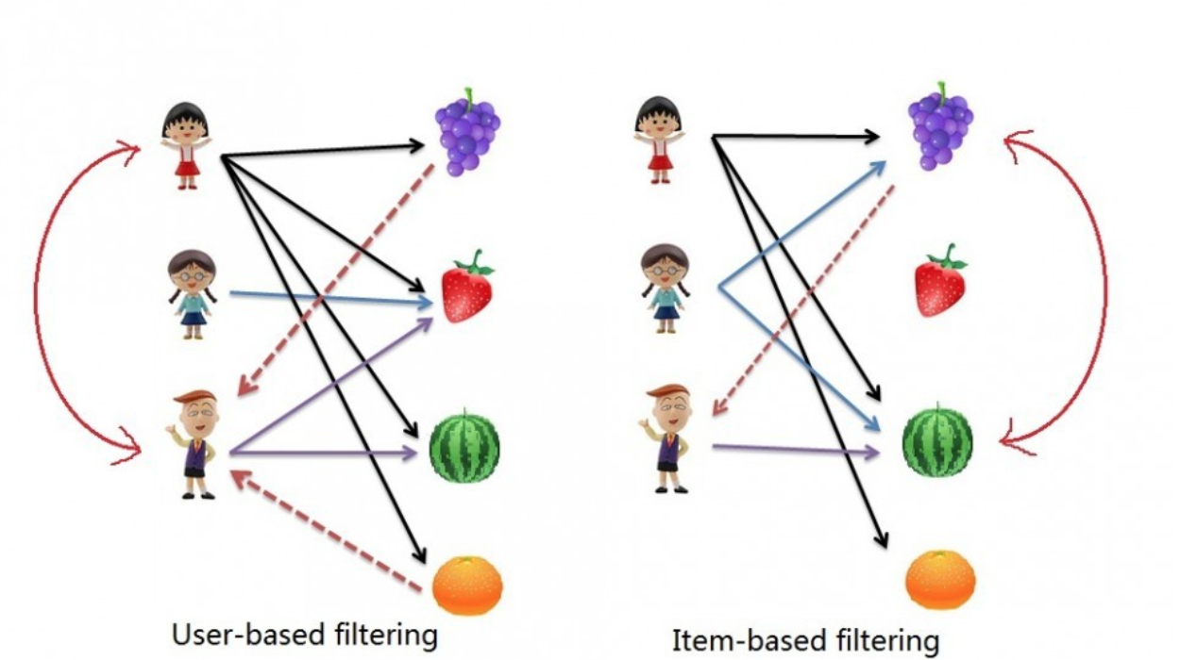
Collaborative Filtering Contd.
User-Based
User 1 and 3 are highly correlated
Item - Based
Item 1 and 3 are highly correlated

Slide 10
Content-Based Filtering
Recommend items are based on the content of the items rather than other user’s opinion.
User profiles are created to describe the type of items that user prefers (Correlation among items)
Recommend items similar to the ones the user has liked (Browsed/purchased) in the past.
Pros:
No need for the data on other users – no cold start and sparsity
Able to recommend users with unique taste (as it is based on items)
Able to recommend new and unpopular items
Cons:
Data should be in structured format (user profile)
Unable to use quality judgements from other users
Notes:
Item - similarity between items is computed based on the ratings instead of the meta data of item content.
Content - The point of content-based is that we have to know the content of both user and item. Usually you construct user-profile and item-profile using the content of shared attribute space.
HYBRID FILTERING - implemented by making content-based and collaborative-based predictions separately and then combining them into one model.
Reduces Cold start and Sparsity problem.

Slide 11
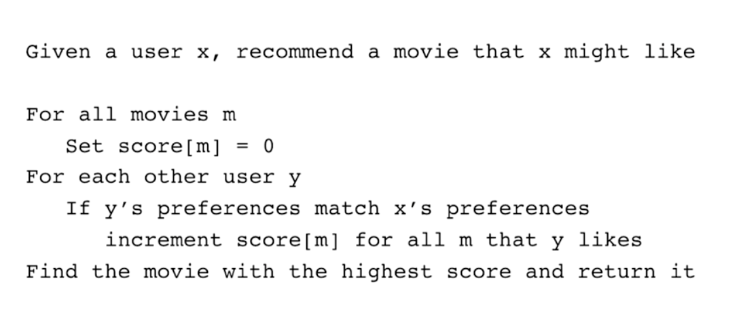
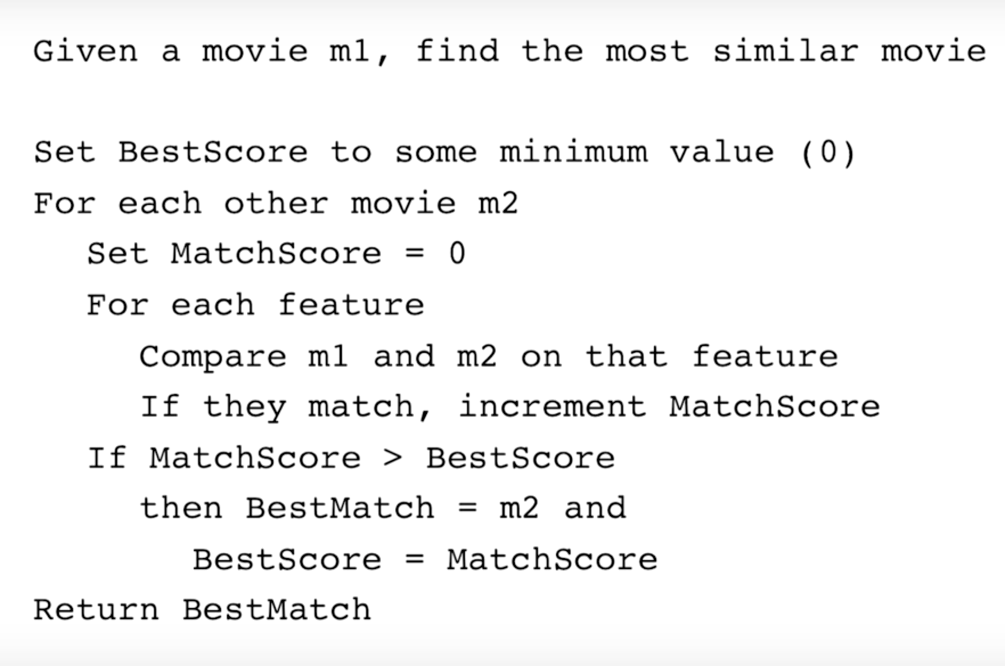
Algorithms
Collaborative Filtering
Content based
Notes:
Comedy, Sitcoms, Drama
Trolls and Smurfs

Slide 12
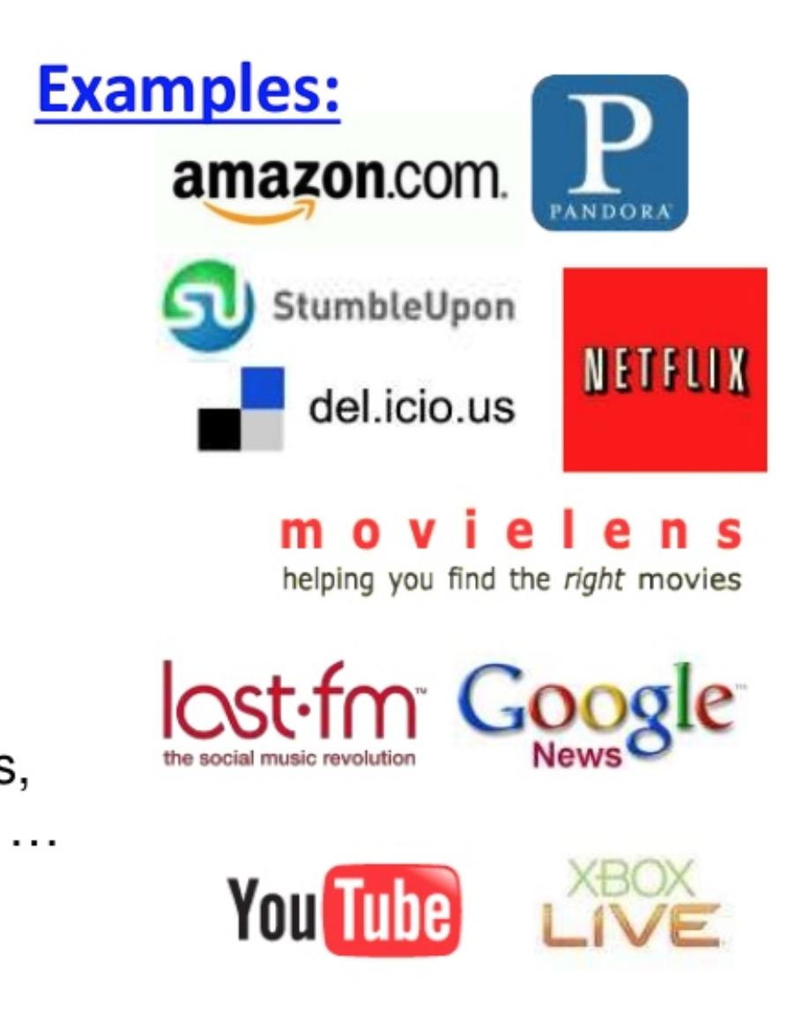
Applications
There are numerous businesses that are gaining advantages of recommendation systems. Popular ones being,
Amazon (product recommendations)
YouTube (video recommendations)
Facebook, Twitter (friend, To Follow recommendations)
Netflix (Movie/Shows recommendations)
Pandora (Music recommendation)

Slide 13
Advantages
Increased Sales and Revenues
Customer Satisfaction
Personalization
Engage customers
Convert Shoppers to Customers
Ad Targeting (Retargeting)

Slide 14

as an Example
Captures BIG DATA
Customize Home pages (Implicit, Explicit and Hybrid Data)
Netflix is a good example of the use of hybrid recommender systems. It makes recommendations by,
comparing the watching and searching habits of similar users (i.e., collaborative filtering)
offering movies that share characteristics with films that a user has rated highly (content-based filtering).
Algorithms:
Restricted Boltzman Machines(RBM)
SVD++ (Single Value Decomposition)
Notes:
Ratings – Popularity – plays – queue addition – members’ interactions – social data – search items – External data(box office performance, reviews)
other features (location, language)
Implicit: based on users’ recent plays, ratings and other interactions
Explicit: taste preferences
Hybrid: Combine the above
RBM are neural networks that have been modified to work in collaborative filtering.
SVD++ is a form of Matrix Factorization
prize of one million dollars to anyone who could improve over the Cinematch

Slide 15

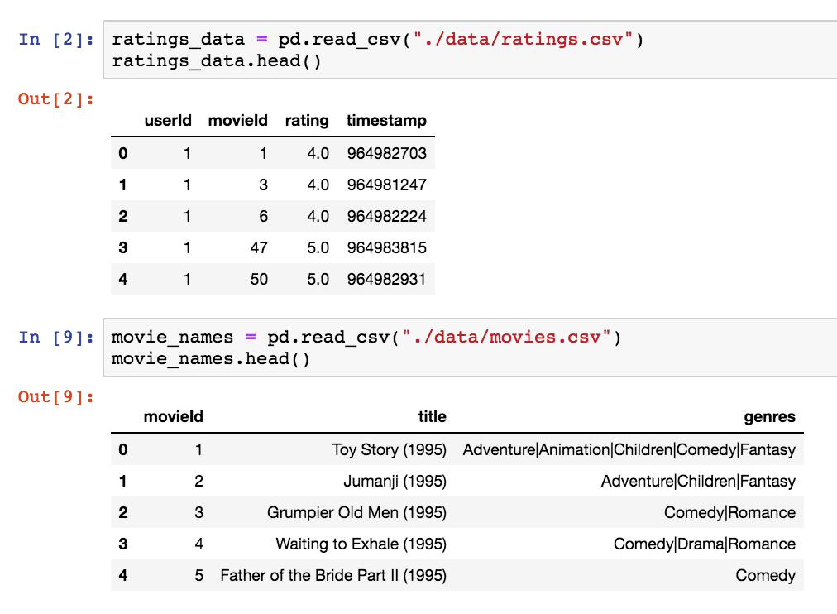
Use Case
Problem Statement:
Given a large set of movies with their ratings from many users, for one particular movie can we predict a small list of similar movies?
Dataset: Movielens
Movies:
movie Id, title, genre
Ratings:
userId, movie Id, rating, timestamp
Load datasets – Movies and Ratings
Notes:
600 users
10,000 movies
100 thousand ratings
Each user represented by a unique id.
Each movie has a unique Id
All users rated at least 20 movies.

Slide 16
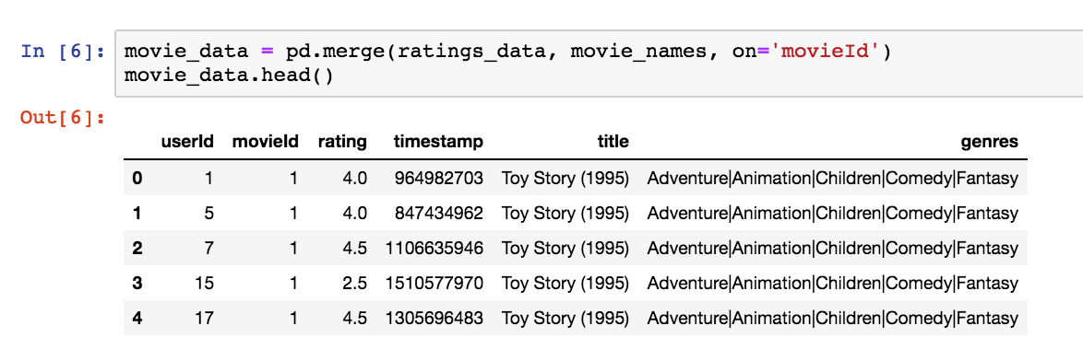
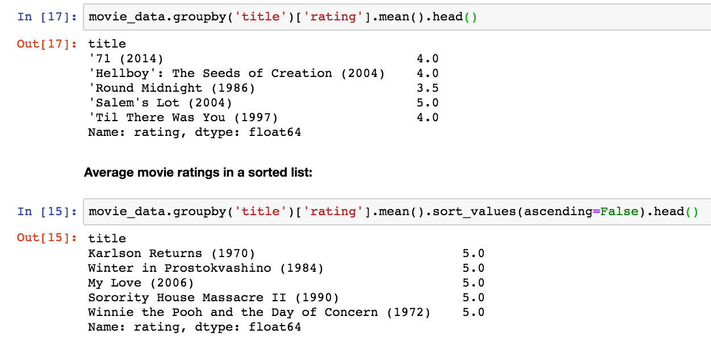
Use Case : Data Prep
Merge on common attribute– movieId
Average rating for each movie - Sort
Notes:
To find out the average rating of each movie, we have to,
group the dataset by the title of the movie
calculate the mean of the rating for each movie
Sort descending
We have ‘average rating per movie’
But, movies with 5 stars rated by just a single user can be on top of the list which is incorrect.
A really good movie gets a higher rating by a large number of users.

Slide 17
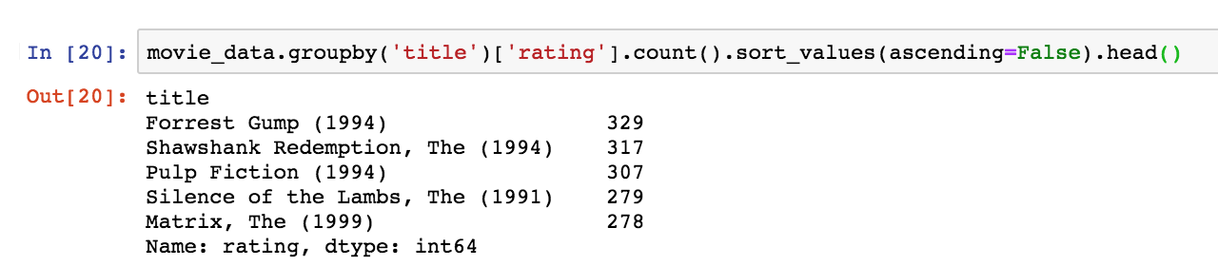
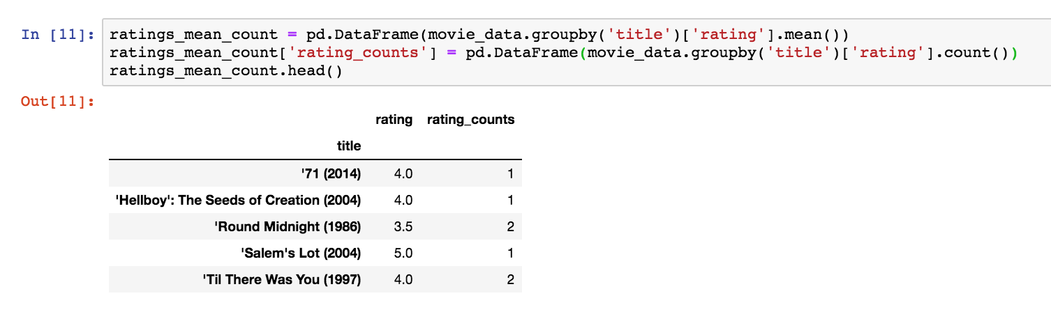
Use Case : Data Prep
Calculate the total number of ratings for a movie and Sort
Create DataFrame to include both – ‘average rating per movie’ and the ’total number of ratings per movie’

Slide 18
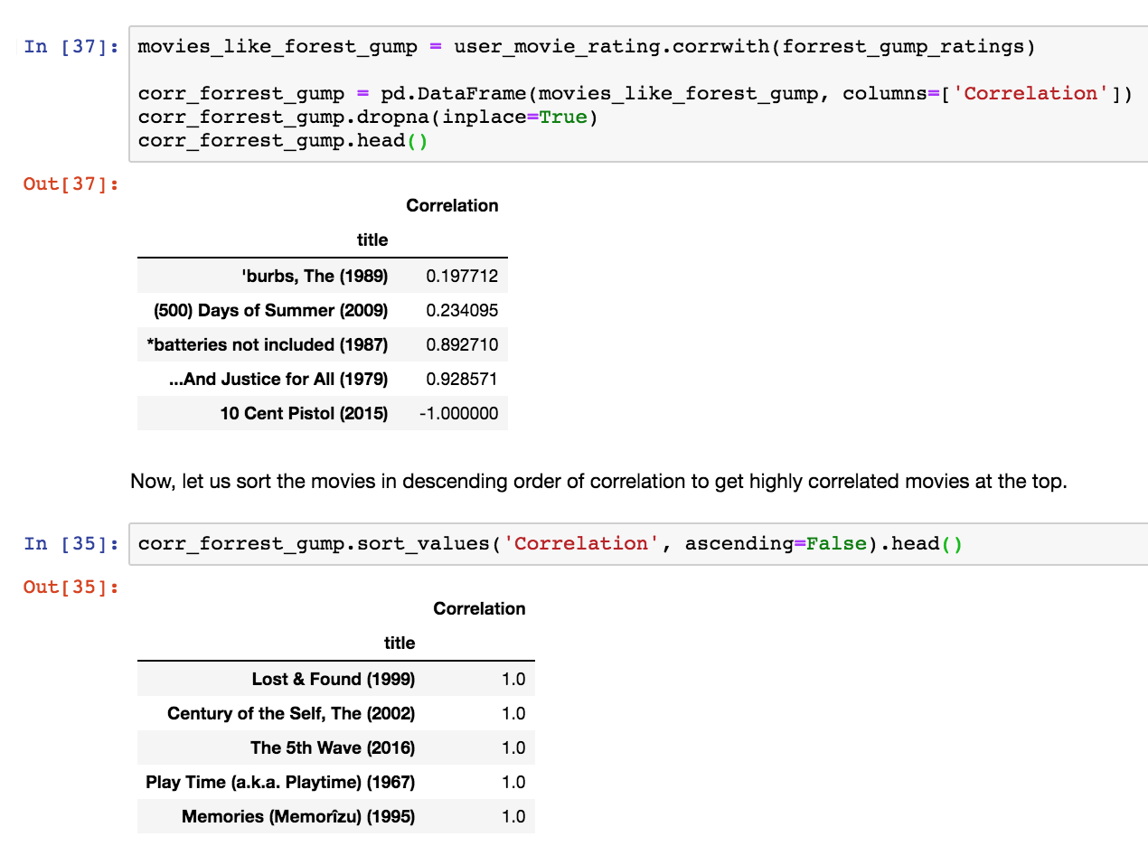
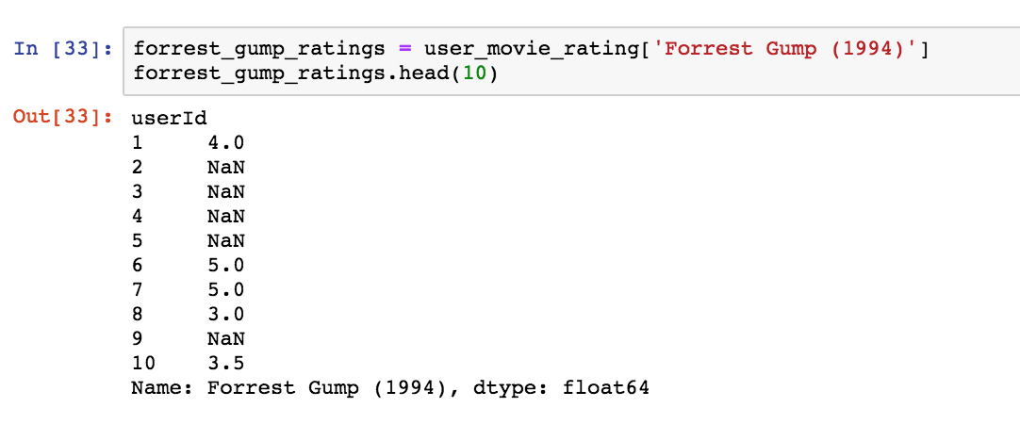
Use Case : Evaluation
Create User-movie-rating matrix
Select a movie to find similarity
Find correlation value with rest of the movies
Sort in descending order of correlation value
Notes:
Compute pairwise correlation between rows or columns of two DataFrame objects.
DataFrame.corrwith(other, axis=0, drop=False)
other : DataFrame, Seriesaxis : {0 or ‘index’, 1 or ‘columns’}, default 0
0 or ‘index’ to compute column-wise, 1 or ‘columns’ for row-wise
drop : boolean, default False
Drop missing indices from result, default returns union of all
------------------
Improve the similarity quotient by retrieving correlated movies with more number of ratings.

Slide 19
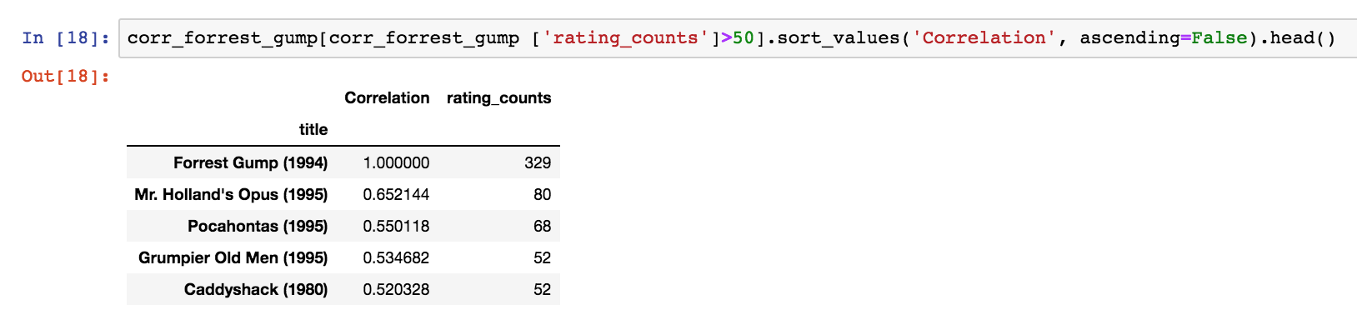
Use Case : Results
Improve similarity by using both factors - ‘correlation’ and ‘more ratings’
Correlated movies with more ratings
Github link:
https://github.com/RashmiPurvachar/big-data-python-class/blob/master/Homeworks/Homework10/PURVACHAR_HW10_RecommenderSystem_Fall2018.ipynb

Slide 20
References
https://stackabuse.com/creating-a-simple-recommender-system-in-python-using-pandas/ - an article by Usman Malik
https://www.youtube.com/watch?v=BKCAkHn8jqA - Recommender Systems tutorial by Simplilearn
https://towardsdatascience.com/what-are-product-recommendation-engines-and-the-various-versions-of-them-9dcab4ee26d5 -
https://towardsdatascience.com/5-advantages-recommendation-engines-can-offer-to-businesses-10b663977673
https://grouplens.org/datasets/movielens/latest/ - Dataset download
https://en.wikipedia.org/wiki/Netflix_Prize - Netflix Prize Compitition for SVD++

Slide 21

So, Questions ??

